Slide 1
Analysis of Factors that Affect Housing Prices in Melbourne
Darian Lam, Haotian Yu, Hye Bae, Van Dang

Slide 2
Predicting House Prices in Melbourne Using ML
Why It Matters
Buying a home is a major financial decision, yet market volatility and numerous influencing factors create uncertainty.
Accurate predictions can provide confidence and clarity for buyers and sellers.
Approach
Utilize ML techniques to predict house prices.
Identify key factors impacting price fluctuations.
Expected Impact
Improve decision-making for stakeholders.
Offer insights into critical factors, enhancing market understanding.

Slide 3
Data Source and Preparation
Dataset Overview: 34,857 housing transactions in Melbourne (2016-2018) from Domain.com.au
Target Variable: "Price"
Predictor Variables: 19 total
Location-related (8): Suburb, Address, Distance, Regionname, CouncilArea, Lat, Long, Postcode
House-related (7): Bedroom2, Bathrooms, Car, Landsize, BuildingArea, Type, YearBuilt
Sale-related (4): Seller, Method, Date, Propertycount
Data Preparation:
1. Dropped irrelevant columns (Seller, Method)
2. Addressed missing data through removal or imputation methods for accurate modeling.
3. Removed outliers using the Z-score method

Slide 4
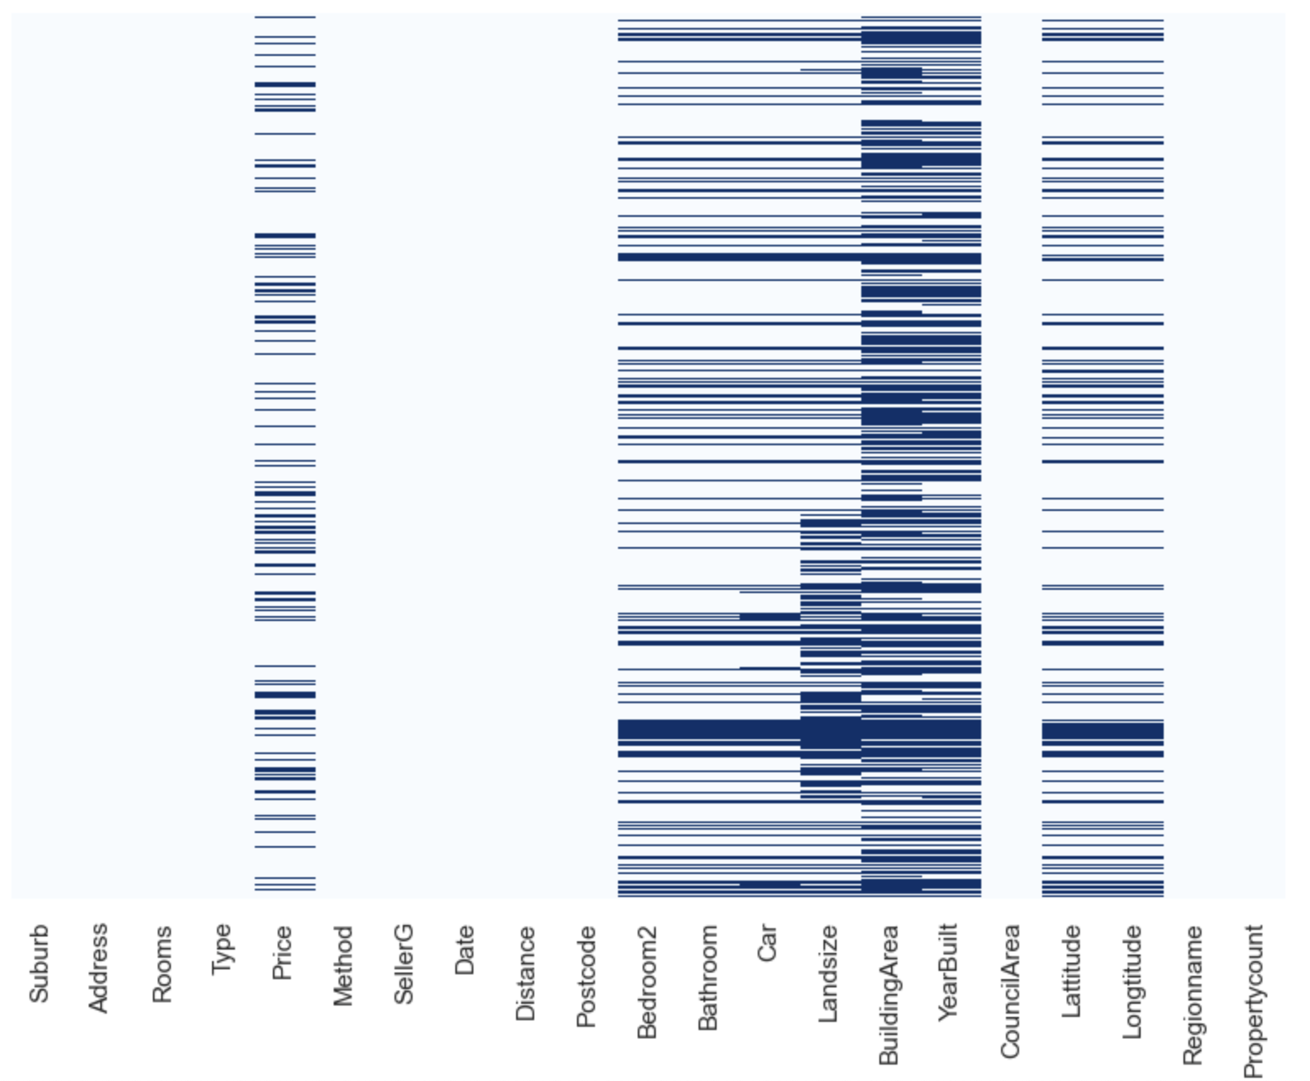
Data Preparation - Dealing with Missing Data & Outliers
Dealing with Missing Data
Removed Columns with over 50% missing values: “YearBuilt”, “BuildingArea”
Columns imputed with median values: Bathroom, Car, Landsize, Propertycount
Columns imputed with Google Maps API: Longitude and Latitude were filled in using the Address and Postcode values via the Google Maps API.
Removed rows with Price missing
Dealing with Outliers
After removing or imputing missing values, outliers were identified as data points with a z-score greater than 3 or less than -3. Approximately 1% of data points were identified as outliers and removed to maintain dataset integrity.
Final number of observations: 23,070
Figure 1. Missing Data by Columns

Slide 5
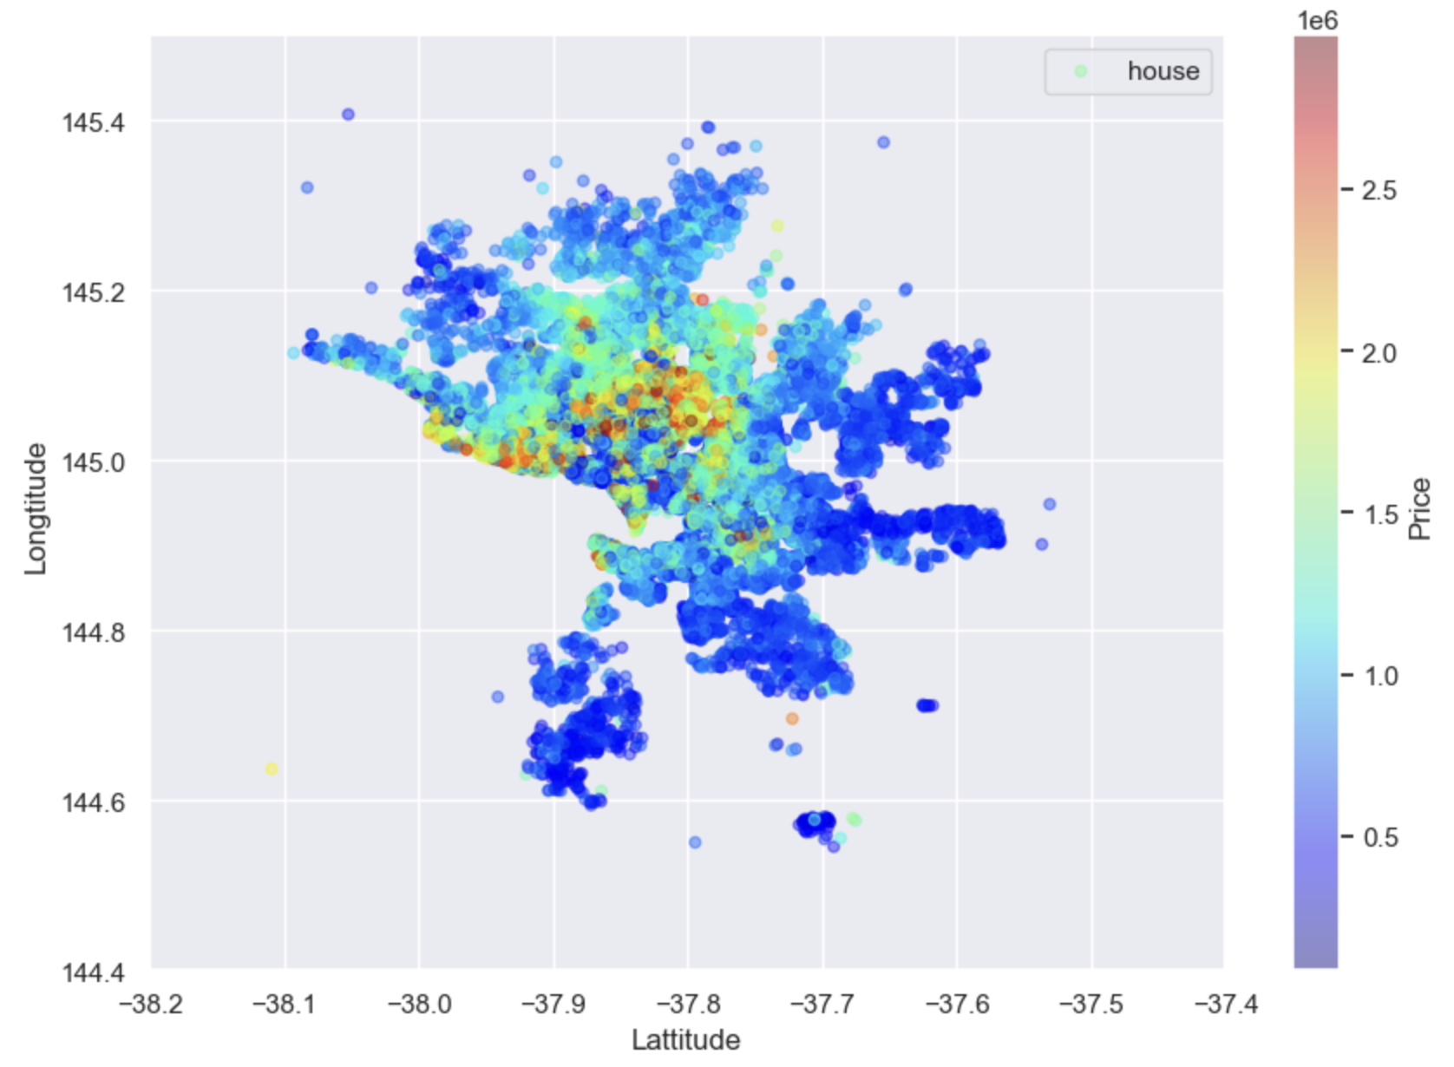
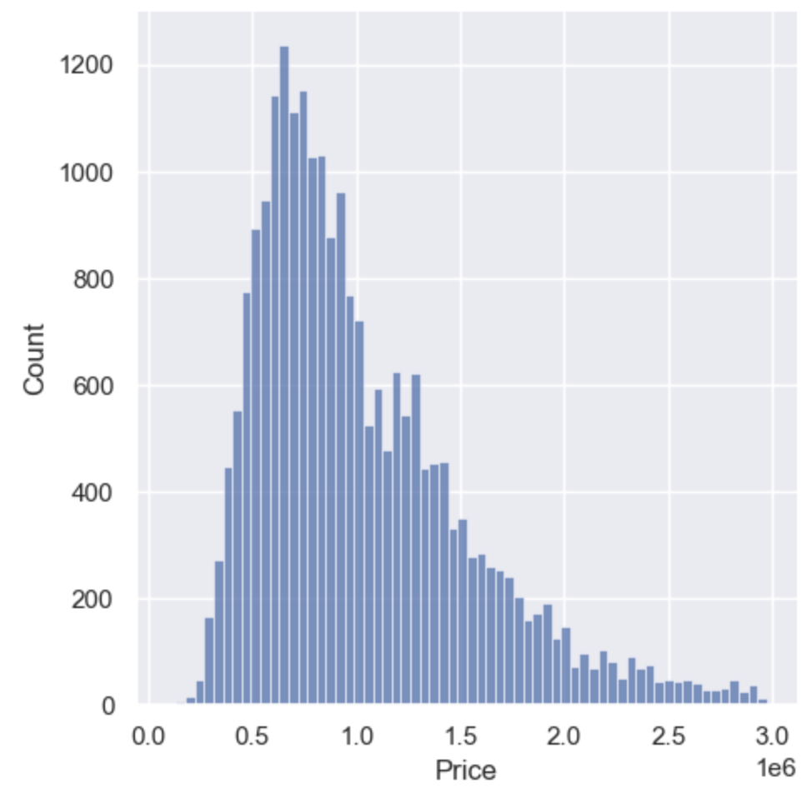
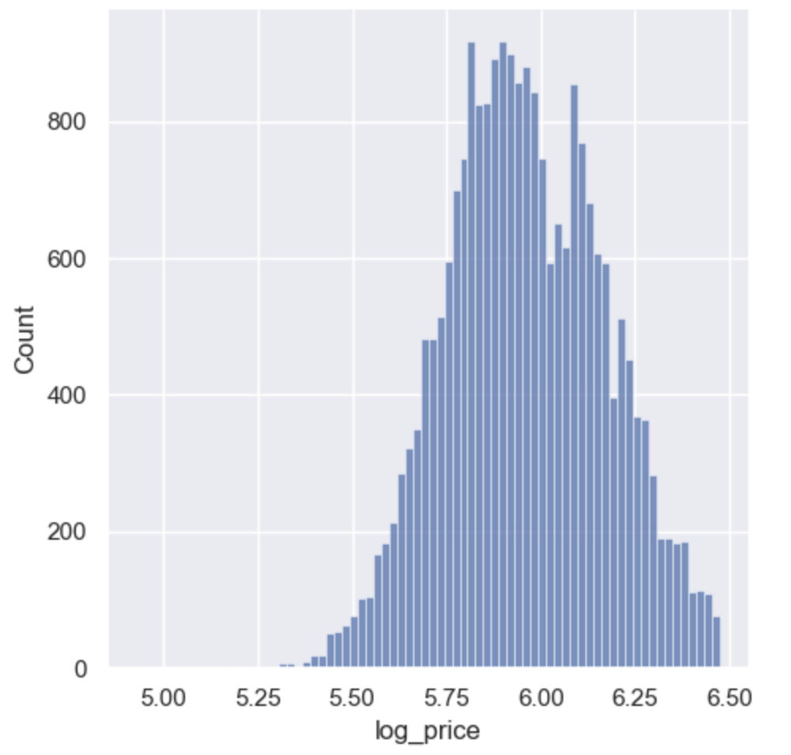
Data Exploration - Descriptive Analysis
The median house has 3 bedrooms, 1 bathroom, 2 parking spaces, and a land size of 448 square meters, with a median price of $888,000 (AUD).
A scatter plot of Longitude and Latitude against Price shows a map of Melbourne, indicating that prices are highest near the city center.
The distribution for Price shows a wide range with a long tail. Therefore, log(Price), which seems to follow a normal distribution, will be utilized as the output variable in the model development process
Figure 3. Distribution of Price (on the left) and Log Price (on the right)
Figure 2. Scatterplot of Longitude and Latitude against Price

Slide 6
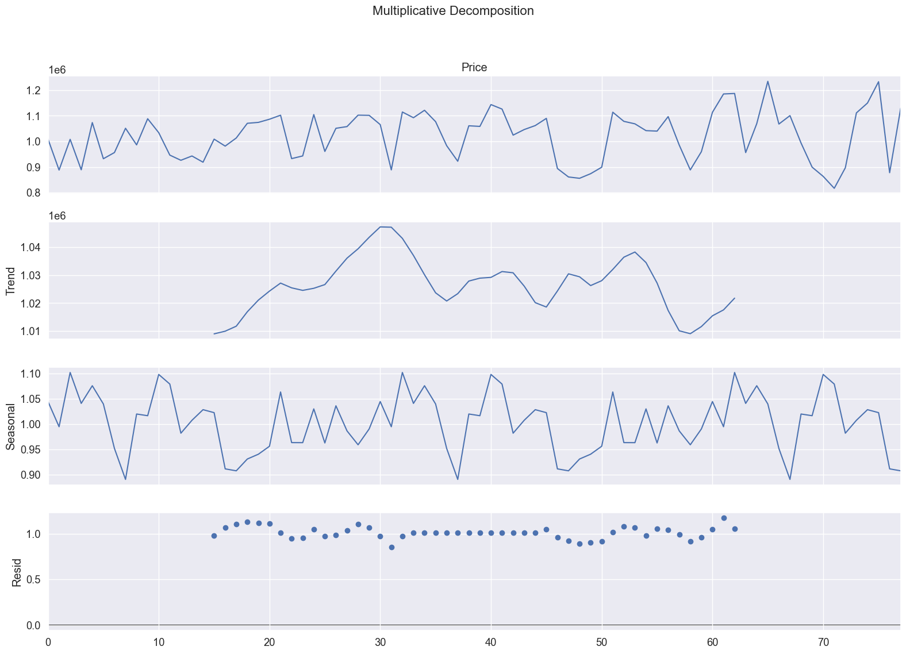
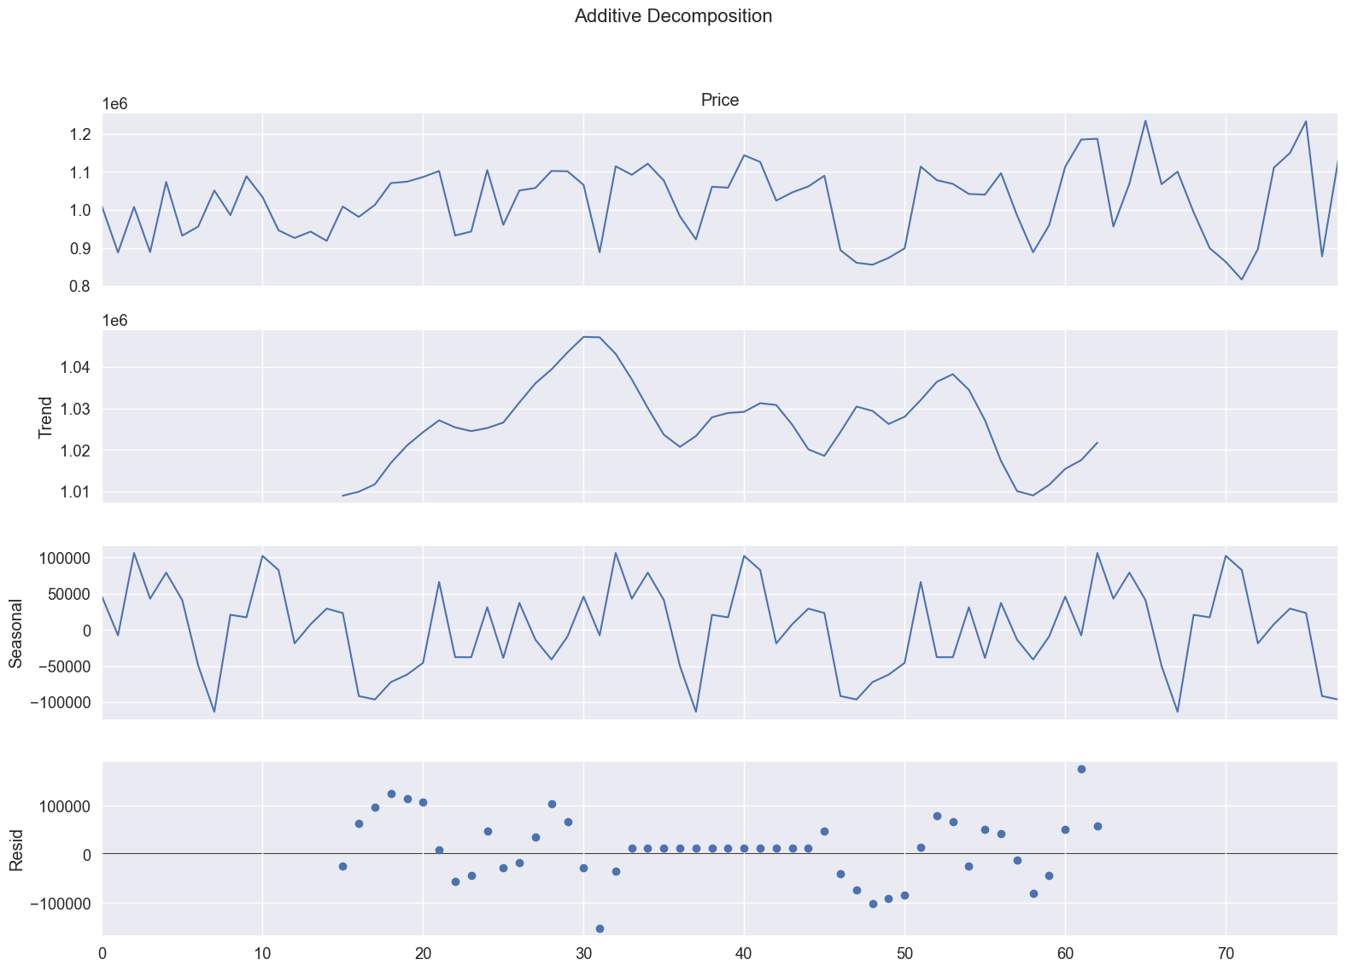
Data Exploration - Exploration of Time Series
Plotting just the price, multiplicative and additive decomposition, we were unable to find significant trends.
Using an iterator library for different parameters, and comparing AIC and BIC, we found the ARIMA(0,0,2) to have the lowest AIC.
As a final step, we put the best model in the SARIMAX function, to get an AIC of 1687 for ARIMA(0,0,2) and enabled the trace parameter for constant.
ARIMA(0,0,2) can be interpreted as:
p = 0, therefore no previous data is used to predict future values
d = 0, therefore no differencing was performed implying the data is relatively stationary
q = 2, therefore the model uses the past two forecast to help adjust the future forecast.
Ultimately we chose to forego time series as a forecasting model because location makes for a larger factor based on our EDA analysis but not all location have large amount of historical house value data.
Figure 4: Time Series Decomposition of Price
No significant trends and seasonality after multiplicative and additive decomposition

Slide 7
Proposed Methodology
For all models, data will be split into the standard 70-30 for training and testing data sets.
When possible, 5 fold cross validation will be used to improve model accuracy and prevent overfitting.
All continuous predictors will be scaled so each predictor can evaluated equally in the model.
The analysis will then use the following models:
Regularization Models: LASSO and Ridge Regression
Based on the EDA, we anticipate that location variables will play an important role in predicting housing prices. There are also a large number of predictors so the use of regularization models will help reduce or identify more significant predictors.
This analysis will show that longitude and latitude are not statistically significant, and prompts us to use postal code.
Baseline Models: Multiple Linear Regression and MLR with stepwise feature selection using AIC criterion.
These models will provide an easily interpretable solution to show the initial relationships between the predictors.
Ensemble Methods with Feature Selection: Random forest (RF), RF with feature selection, XGBoosting, XGB with feature selection, Adaboost, Adaboost with feature selection, Stacking, and Blending.
These previous models found that the predictors had non-linear and complex interactions so this prompt the use of powerful ensemble models to better capture this relationship.

Slide 8
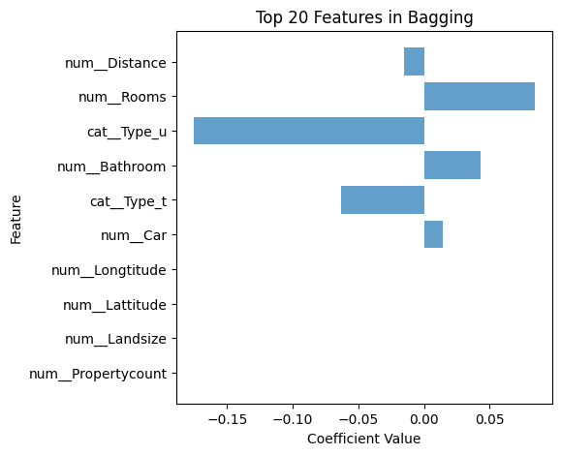
Method (1) - LASSO and Ridge with Bagging
LASSO and Ridge were performed with tuning and cross validation.
Both models performed rather poorly as shown in the table below.
Bagging was applied in an attempt to increase predictive power but had little impact to the model.
It is notable that the coefficients of latitude, longitude, landsize, and property count were almost eliminated in the LASSO bagging model.
This signals that many of the variables do not have strong predictive power.
This indicates that the project should attempt other methods.
 | Lambda | R^2 | RMSE
LASSO | 0.0001 | 0.5041 | 0.1470
LASSO W/ Bagging | 0.0001 | 0.5041 | 0.1470
Ridge | 10 | 0.5042 | 0.1470
Ridge W/Bagging | 10 | 0.5041 | 0.1470
Figure 5: Coefficients of Predictors for LASSO with Bagging
Table 1: Results of Regularization Models

Slide 9
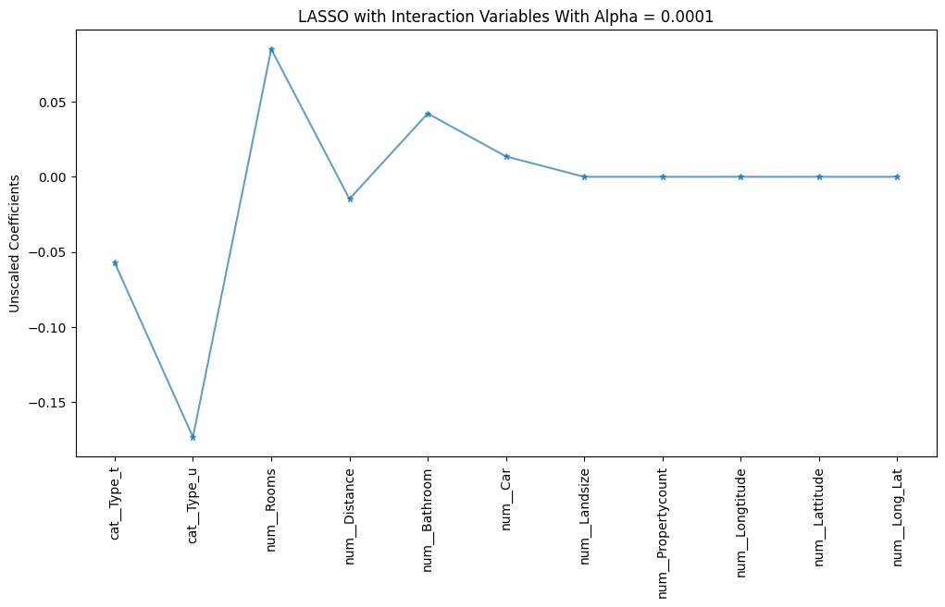
Method (2) - LASSO with Interaction Variables
It is likely that LASSO applies regularization to each predictor independently and could downplay the relationship between the two predictors, specifically the latitude and longitude variables.
This leads us to attempt to create interaction variables of latitude and longitude to capture the spatial relationship between the two predictors.
However, the results are very similar to to the original LASSO and even the interaction variable is reduced to zero, indicating that the small differences between longitude and latitude do not have a major impact on the model’s performance.
Figure 6: Coefficients of Predictors for LASSO with Interaction Variables
 | Lambda | R^2 | RMSE
LASSO | 0.0001 | 0.5041 | 0.1470
LASSO W/ Interaction Variable | 0.001 | 0.5036 | 0.1471
Table 2: Results of LASSO with Interaction Variables

Slide 10
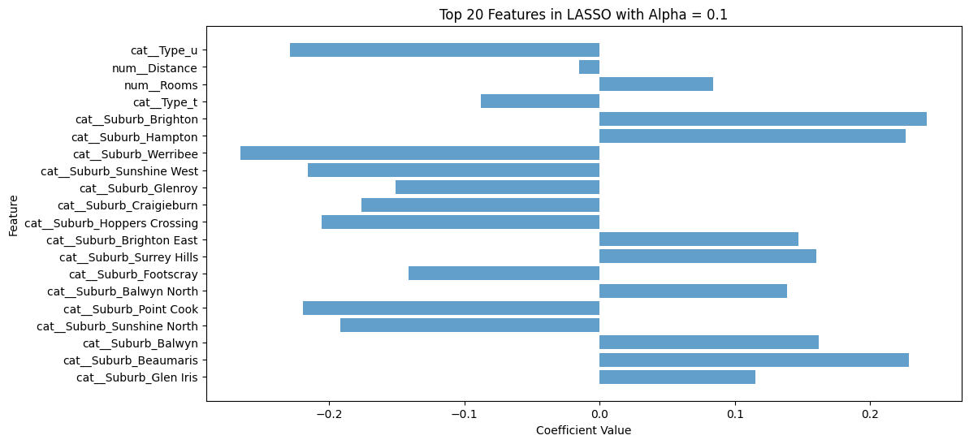
Method (3) - LASSO with Suburb
Instead of longitude and latitude, suburb was chosen as a location variable to predict the price.
This model with suburb proves to be more accurate but LASSO turns each value of suburb into predictors. This drastically impacts the interpretability of the model.
Figure 7: Coefficients of Predictors for LASSO with Suburb and Bagging
 | Lambda | R^2 | RMSE
LASSO W/ Suburb | 0.0001 | 0.7695 | 0.1002
LASSO W/ Suburb and Bagging | 0.0001 | 0.7695 | 0.1002
Table 3: Results of LASSO with Suburb and Bagging

Slide 11
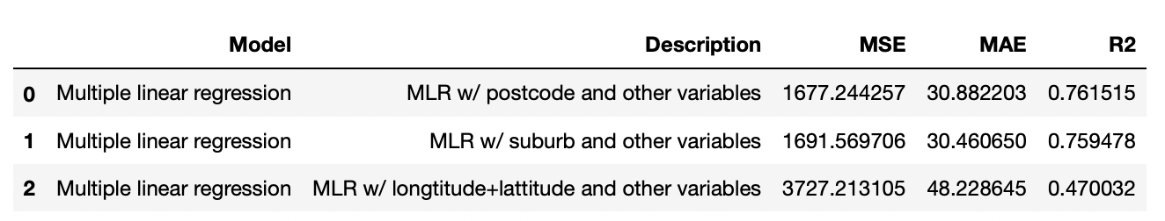
Method (4-1) - MLR (w/ different location variables) Results
First, we compared MLR models with different location variables in order to mitigate multicollinearity in the regression models. Since only regression models would be affected (Tree models can handle multicollinearity and non-linearity intrinsically), we chose the Multiple Linear Regression model to perform this comparison.
The results using postcode and suburb show clear improvement over longitude and latitude using the regression approach.
We decided on postcode as the location variable and proceeded with an AIC stepwise feature selection for the rest of predictor variables.
Table 4: Comparison of performance of multiple linear regression with different location variables

Slide 12
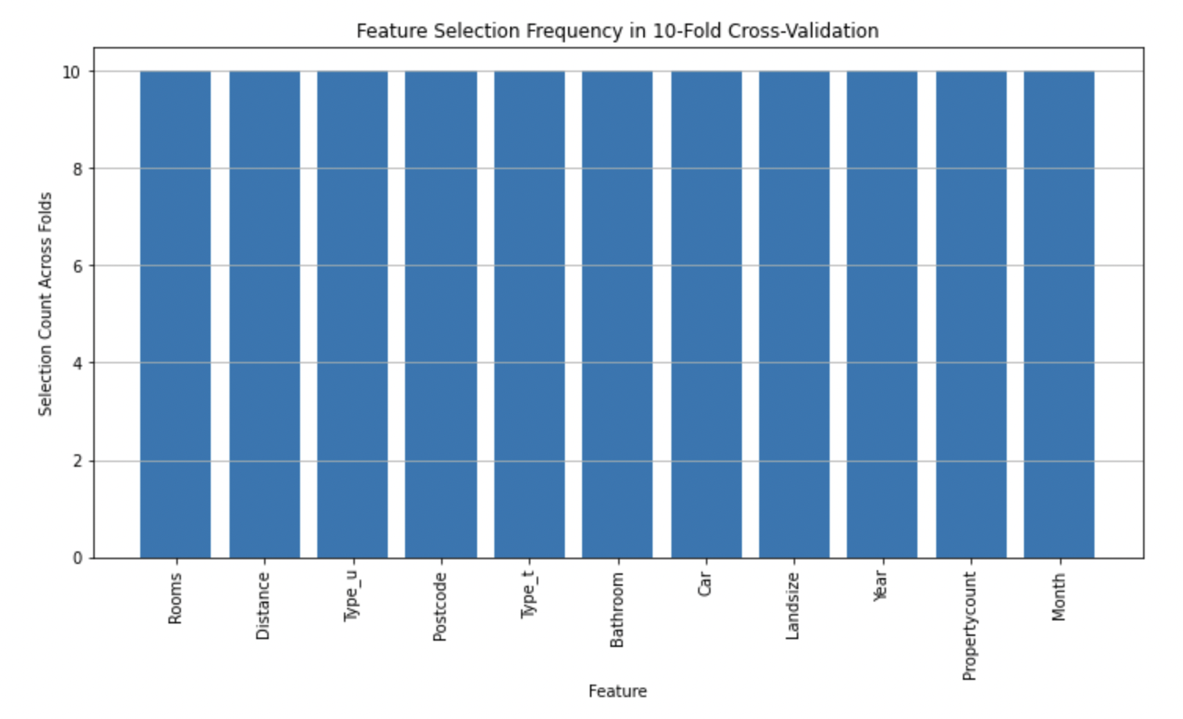
Method (4-2) - MLR with AIC stepwise feature selection
Baseline Model: Started with a Multiple Linear Regression using all features to predict housing prices.
AIC and Stepwise Selection: Used AIC to optimize model simplicity and accuracy by removing less significant features through stepwise selection.
Outcome: All features were retained, indicating each variable contributed meaningful information to the model.
Implication: Suggests housing prices are influenced by multiple factors, justifying the use of complex models in further analysis.
Figure 8: Features’ frequency plot during stepwise elimination

Slide 13
Method (5) - Trees/ Boosting/ Ensemble models
Tree Models with Tuning:
Random Forest, XGBoost, and AdaBoost, each tested with and without feature selection
Stacking:
Combined RF, XGBoost, and AdaBoost as base models with optimized parameters.
Used a Linear Regression model as the meta model.
Blending:
Averaged predictions from the three base models to reduce overfitting.
Averaging approach can be adjusted to improve results.
Models | Parameters tested in GridSearchCV (Optimal parameters in red)
Random Forest | n_estimators: [50, 100, 200], max_depth: [10, 20, None], min_samples_split: [2, 10], Feature selection with RandomForestRegressor
XGBoost | n_estimators: [50, 100, 200], max_depth: [3, 6, 10], learning_rate: [0.01, 0.1, 0.2], Feature selection with XGBRegressor
AdaBoost | n_estimators: [50, 100, 200], learning_rate: [0.01, 0.1, 1]
Table 5: Table of parameters tested with optimal parameters for tree models
Notes:
Haotian: Elaborate on how the models are used and how they work

Slide 14
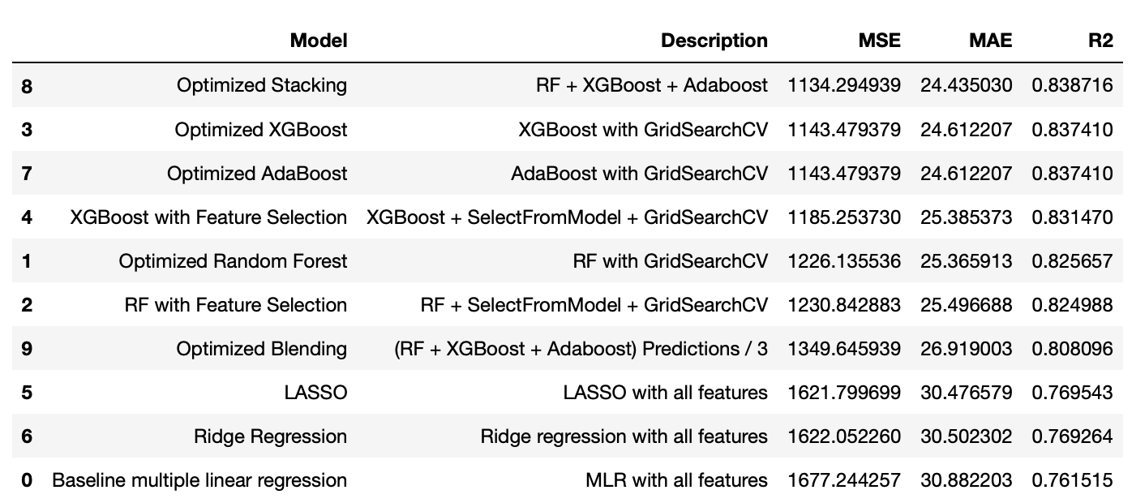
Results of All Models Tested
Table 6: Consolidated results of all models ran, ranked by MSE

Slide 15
Conclusion
In summary, this project analyzes transactional housing data in Melbourne and performs data preparation to create a clean dataset. Various methods are then tested with iterative variable selection.
Based on the MSE values, the best performing model is the stacked ensemble model which explains 83.9% of the variability in the response variable.
The model deems all variables as important and is in line with our overall findings from other model analyses.
We could see that feature selection on the optimized model always gave worse results than the optimized base model itself.
To further enhance our model, additional exploration is needed to include other features with greater explanatory power, such as the age of the house or the building size, which were previously excluded due to the large number of missing values.
In order to test the robustness of the model, it is recommended to test the model with the housing price datasets from other cities and evaluate the accuracy.

